Slide 1
LifeCycle Of A Testing Bug
Name: Jashwanth Kumar S
Reg No: 20BCS0139

Slide 2
Bug In SDLC
A software bug is an error or fault in a computer program making it behave in unexpected ways. Bugs can be present at any stage during SDLC (Software development LifeCycle), or at the designing phase, development phase, user acceptance testing phase or even by the user.

Slide 3
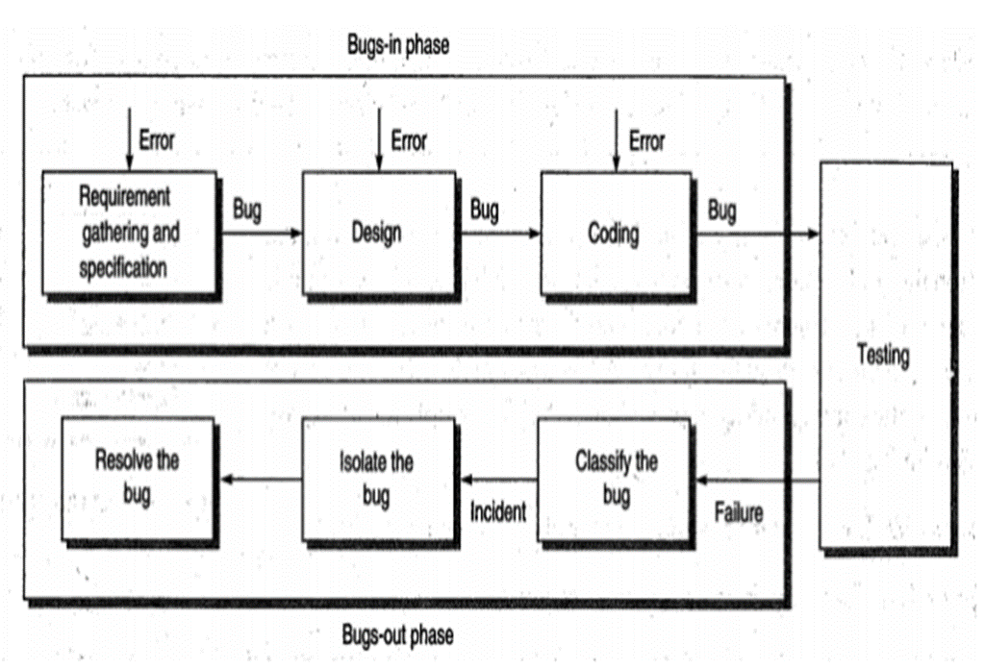

Slide 4
BUG Life Cycle
Requirement Bug
Design Bug
Control flow Bug
Logic Bug
Race condition bug

Slide 5
Coding Bug
Processing Bug
Data flow Bug
Control flow bug

Slide 6
Coding Bug
Error handling Bug
Boundary related Bug
User interface Bug
System Bug

Slide 7
BUG - Levels
Critical BUG
Major BUG
Moderate BUG
Minor BUG

Slide 8
Thank You

